Slide 1
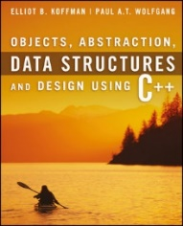
Welcome to
CS 235 Data Structures
Sorting (34)
Chapter 10.1-3, pgs. 555-564

Slide 2
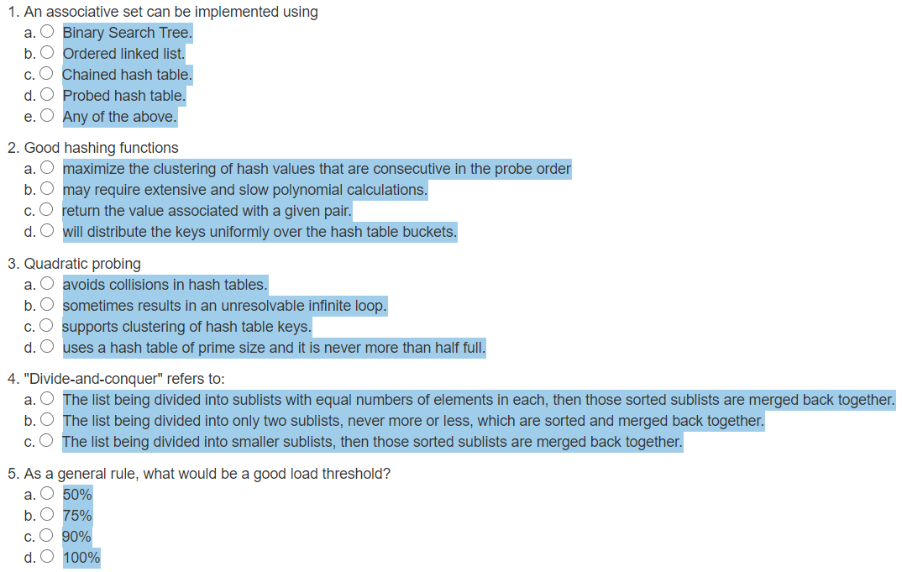
Attendance Quiz #33

Slide 3
Tip #34: Non-compiler Performance
Don't define object variables before their use/initialization, which necessitates that the constructor AND assignment operator functions will run – could be costly for complex objects.
Consider the order of evaluation of compound conditionals. e.g., given if (a && b), if b is more likely to be false, place it first to save the evaluation of a.
Minimize the use of temporaries (particularly with string-based processing).
Use heap memory (dynamic allocation) only when necessary as dynamic allocations and deallocations are expensive. (Many C++ programmers over-use the heap.)
Know your compiler/linker options, especially which ones cause non-standard behavior. These dramatically affect runtime performance.
Know the performance/functionality tradeoffs of the STL containers (e.g., don't frequently insert into a vector, use a list).

Slide 4
L09 - Pokémon

Slide 5
Associative Set/Map Implementations
Ordered Set (BST)
ordered, unique
Ο(log n) search
Ordered Set (Linked List)
unordered, duplicates
push_front(item) -> addNode(item);
Ο(n) search
or
 | cat
 |  | dog
 | dog
∅ | ∅ | cat
 | ∅ | pig
 | horse
∅ | ∅ | horse
∅ | pig
✗
Unordered Hash Map (Chained)
Bucketed ordered list
unordered, unique (?)
Ο(1) average search
Unordered Hash Map (Open addressing)
Linear or Quadratic probe
unordered, unique
Ο(1) average search
Quadratic probe
∅
∅
∅
∅
 | cat
cat
dog
horse
pig
∅
∅
∅
cat
cat
dog
horse
pig
∅ | dog
dog
∅ | pig
pig
∅ | horse
horse

Slide 6
Pokémon Maps and Sets
Pokemon:
Charmander fire (1)
Bulbasaur grass (1)
Squirtle water (1)
HashMap<string,string> pokemon;
HashMap<string,string> moves;
pair<string,string>
pair<string,string>
[0] | "Squirtle" | "water"
[1] | "Charmander" | "fire"
[2] | "Bulbasaur" | "grass"
[3] | "" | ""
[4] | "" | ""
[0] | "" | ""
[1] | "razor_leaf" | "grass"
[2] | "water_gun" | "water"
[3] | "flamethrower" | "fire"
[4] | "" | ""
Moves:
flamethrower fire (3)
water_gun water (2)
razor_leaf grass (2)
HashMap<string,Set<string>> effectivities;
pair<string,Set<string>>
Set<string>
[0] | "grass"
[1] | "" | NULL
[2] | "fire"
[3] | "" | NULL
[4] | "water"
"ground" | "rock" | "water"
"bug" | "grass" | "ice"
"fire" | "ground" | "rock"
Effectivities:
fire grass ice bug (2)
water ground rock fire (4)
grass water ground rock (4)
HashMap<string,Set<string>> ineffectivities;
pair<string,Set<string>>
Set<string>
Ineffectivities:
fire fire water rock (2)
water water grass (4)
grass grass bug fire (4)
[0] | "grass"
[1] | "" | NULL
[2] | "fire"
[3] | "" | NULL
[4] | "water"
"bug" | "fire" | "grass"
"fire" | "water" | "rock"
"grass" | "water"

Slide 7
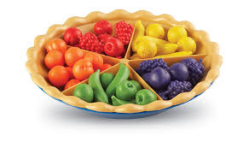
10.1 Using C++ Sorting Functions
10.1, pgs. 570-572

Slide 8
Chapter Objectives
To learn how to use the standard sorting functions in algorithm.h.
To learn how to implement the following sorting algorithms:
selection sort
bubble sort
insertion sort
Shell sort
merge sort
heapsort
quicksort
To understand the difference in performance of these algorithms, and which to use for small, medium, and large arrays.
Sorting entails arranging data in decreasing (or non-increasing) or increasing (or non-decreasing) order
Familiarity with sorting algorithms is an important programming skill.
The study of sorting algorithms provides insight into problem solving techniques such as divide and conquer.
the analysis and comparison of algorithms which perform the same task.

Slide 9
Using C++ Sorting Methods
The Standard C++ Library (in algorithm.h) provides versions of sorting functions using a pair of random-access iterators:
template<typename RI>
void sort(RI first, RI last);
template<typename RI, typename Compare>
void sort(RI first, RI last, Compare comp);
Because these functions require random-access iterators, they can be used only with vectors, deques, and ordinary C pointers (for sorting arrays).
Note: The list container supports only bidirectional iterators, so it provides its own sort member function.
If we use the second version of function sort, we must also pass an object that implements a comparison function (functor).

Slide 10
Using C++ Sorting Methods
If people_list is a vector of Person objects, then:
sort(people_list.begin(), people_list.end(),
Compare_Person());
sorts the elements in people_list in ascending order based on their names.
The Compare_Person function class is used to compare objects:
struct Compare_Person
{
bool operator()(const Person& p1, const Person& p2)
{
return ((p1.family_name < p2.family_name) ||
((p1.family_name == p2.family_name)
&& (p1.given_name < p2.given_name));
}
}

Slide 11
Using C++ Sorting Methods
If array items stores a collection of 16 integers, the array is sorted by:
sort(items, items + 16);
This statement sorts only the first half of the array, leaving the rest untouched:
sort(items, items + 8);
This function call sorts the array in descending order:
sort(items, items + 16, greater<int>());
where greater<int> implements the comparison operator> for integers (defined in library functional).

Slide 12
Using C++ Sorting Methods
There are also two functions named stable_sort, which are similar to the sort functions.
The primary difference is that elements that are equal may not retain their relative ordering when sort is used, but they will retain their relative ordering when stable_sort is used.
In other words, if there are two occurrences of an item, the one that is first in the unsorted array is guaranteed to be first in the sorted array only if stable_sort is used.
This function call sorts an array in descending order:
stable_sort(items, items + 16, greater<int>());
The sort function is slightly faster than stable_sort, so it should be used whenever the relative ordering of equal elements is unimportant.

Slide 13
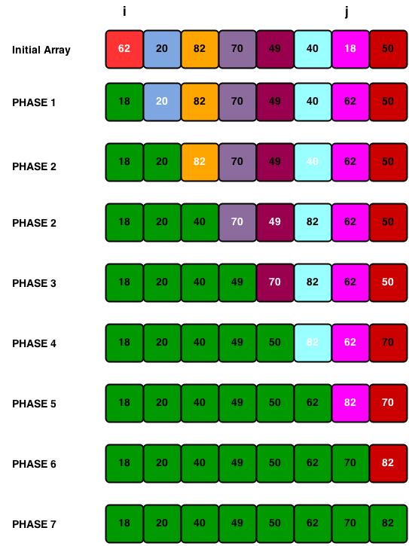
10.2 Selection Sort
10.3 Bubble Sort
10.2, pgs. 572-580

Slide 14
Selection Sort and Bubble Sort
Selection sort is relatively easy to understand.
The array is sorted by making several passes through the array, selecting a next smallest item in the array each time and placing it where it belongs in the array.
Bubble sort (also known as sinking sort) is also a simple sorting algorithm
The array is sorted by repeatedly stepping through the array, comparing adjacent pairs, and swapping them if they are in the wrong order, until the array is sorted.
Smaller values bubble up to the top of the array and larger values sink to the bottom; hence the name.
Selection sort and Bubble sort are quadratic sorts.

Slide 15
Selection Sort
Selection sort is relatively easy to understand.
It sorts an array by making several passes through the array, exchanging items if smaller.
For simplicity, we illustrate all the sorting algorithms using an array of integer values.
for fill = 0 to n – 2
for next = fill + 1 to n – 1
if item[next] < item[fill]
exchange item[pos_min],item[fill]
endfor
endfor
0
1
2
3
4
35
65
30
60
20

Slide 16
Trace of Selection Sort
for fill = 0 to n – 2
for next = fill + 1 to n – 1
if item[next] < item[fill]
exchange item[pos_min],item[fill]
endfor
endfor
0
1
2
3
4
35
65
30
60
20
n | 5
fill | 0
next
fill

Slide 17
Trace of Selection Sort
for fill = 0 to n – 2
for next = fill + 1 to n – 1
if item[next] < item[fill]
exchange item[pos_min],item[fill]
endfor
endfor
0
1
2
3
4
35
65
30
60
20
n | 5
fill | 0
next | 1
fill
next

Slide 18
Trace of Selection Sort
for fill = 0 to n – 2
for next = fill + 1 to n – 1
if item[next] < item[fill]
exchange item[pos_min],item[fill]
endfor
endfor
0
1
2
3
4
35
65
30
60
20
n | 5
fill | 0
next | 1
fill
next

Slide 19
Trace of Selection Sort
for fill = 0 to n – 2
for next = fill + 1 to n – 1
if item[next] < item[fill]
exchange item[pos_min],item[fill]
endfor
endfor
0
1
2
3
4
35
65
30
60
20
n | 5
fill | 0
next | 2
fill
next

Slide 20
Trace of Selection Sort
for fill = 0 to n – 2
for next = fill + 1 to n – 1
if item[next] < item[fill]
exchange item[pos_min],item[fill]
endfor
endfor
0
1
2
3
4
35
65
30
60
20
n | 5
fill | 0
next | 2
fill
next

Slide 21
Trace of Selection Sort
for fill = 0 to n – 2
for next = fill + 1 to n – 1
if item[next] < item[fill]
exchange item[pos_min],item[fill]
endfor
endfor
0
1
2
3
4
30
65
35
60
20
n | 5
fill | 0
next | 2
fill
next

Slide 22
Trace of Selection Sort
for fill = 0 to n – 2
for next = fill + 1 to n – 1
if item[next] < item[fill]
exchange item[pos_min],item[fill]
endfor
endfor
0
1
2
3
4
30
65
35
60
20
n | 5
fill | 0
next | 3
fill
next

Slide 23
Trace of Selection Sort
for fill = 0 to n – 2
for next = fill + 1 to n – 1
if item[next] < item[fill]
exchange item[pos_min],item[fill]
endfor
endfor
0
1
2
3
4
30
65
35
60
20
n | 5
fill | 0
next | 3
fill
next

Slide 24
Trace of Selection Sort
for fill = 0 to n – 2
for next = fill + 1 to n – 1
if item[next] < item[fill]
exchange item[pos_min],item[fill]
endfor
endfor
0
1
2
3
4
30
65
35
60
20
n | 5
fill | 0
next | 4
fill
next

Slide 25
Trace of Selection Sort
for fill = 0 to n – 2
for next = fill + 1 to n – 1
if item[next] < item[fill]
exchange item[pos_min],item[fill]
endfor
endfor
0
1
2
3
4
30
65
35
60
20
n | 5
fill | 0
next | 4
fill
next

Slide 26
Trace of Selection Sort
for fill = 0 to n – 2
for next = fill + 1 to n – 1
if item[next] < item[fill]
exchange item[pos_min],item[fill]
endfor
endfor
0
1
2
3
4
20
65
35
60
30
n | 5
fill | 0
next | 4
fill
next

Slide 27
Trace of Selection Sort
for fill = 0 to n – 2
for next = fill + 1 to n – 1
if item[next] < item[fill]
exchange item[pos_min],item[fill]
endfor
endfor
0
1
2
3
4
20
65
35
60
30
n | 5
fill | 0
next | 5
fill
next

Slide 28
Trace of Selection Sort
for fill = 0 to n – 2
for next = fill + 1 to n – 1
if item[next] < item[fill]
exchange item[pos_min],item[fill]
endfor
endfor
0
1
2
3
4
20
65
35
60
30
n | 5
fill | 1
next | 4
fill
next

Slide 29
Trace of Selection Sort
for fill = 0 to n – 2
for next = fill + 1 to n – 1
if item[next] < item[fill]
exchange item[pos_min],item[fill]
endfor
endfor
0
1
2
3
4
20
65
35
60
30
n | 5
fill | 1
next | 2
fill
next

Slide 30
Trace of Selection Sort
for fill = 0 to n – 2
for next = fill + 1 to n – 1
if item[next] < item[fill]
exchange item[pos_min],item[fill]
endfor
endfor
0
1
2
3
4
20
65
35
60
30
n | 5
fill | 1
next | 2
fill
next

Slide 31
Trace of Selection Sort
for fill = 0 to n – 2
for next = fill + 1 to n – 1
if item[next] < item[fill]
exchange item[pos_min],item[fill]
endfor
endfor
0
1
2
3
4
20
35
65
60
30
n | 5
fill | 1
next | 2
fill
next

Slide 32
Trace of Selection Sort
for fill = 0 to n – 2
for next = fill + 1 to n – 1
if item[next] < item[fill]
exchange item[pos_min],item[fill]
endfor
endfor
0
1
2
3
4
20
35
65
60
30
n | 5
fill | 1
next | 3
fill
next

Slide 33
Trace of Selection Sort
for fill = 0 to n – 2
for next = fill + 1 to n – 1
if item[next] < item[fill]
exchange item[pos_min],item[fill]
endfor
endfor
0
1
2
3
4
20
35
65
60
30
n | 5
fill | 1
next | 3
fill
next

Slide 34
Trace of Selection Sort
for fill = 0 to n – 2
for next = fill + 1 to n – 1
if item[next] < item[fill]
exchange item[pos_min],item[fill]
endfor
endfor
0
1
2
3
4
20
35
65
60
30
n | 5
fill | 1
next | 4
fill
next

Slide 35
Trace of Selection Sort
for fill = 0 to n – 2
for next = fill + 1 to n – 1
if item[next] < item[fill]
exchange item[pos_min],item[fill]
endfor
endfor
0
1
2
3
4
20
35
65
60
30
n | 5
fill | 1
next | 4
fill
next

Slide 36
Trace of Selection Sort
for fill = 0 to n – 2
for next = fill + 1 to n – 1
if item[next] < item[fill]
exchange item[pos_min],item[fill]
endfor
endfor
0
1
2
3
4
20
30
65
60
35
n | 5
fill | 1
next | 4
fill
next

Slide 37
Trace of Selection Sort
for fill = 0 to n – 2
for next = fill + 1 to n – 1
if item[next] < item[fill]
exchange item[pos_min],item[fill]
endfor
endfor
0
1
2
3
4
20
30
65
60
35
n | 5
fill | 1
next | 5
fill
next

Slide 38
Trace of Selection Sort
for fill = 0 to n – 2
for next = fill + 1 to n – 1
if item[next] < item[fill]
exchange item[pos_min],item[fill]
endfor
endfor
0
1
2
3
4
20
30
65
60
35
n | 5
fill | 2
next | 5
fill
next

Slide 39
Trace of Selection Sort
for fill = 0 to n – 2
for next = fill + 1 to n – 1
if item[next] < item[fill]
exchange item[pos_min],item[fill]
endfor
endfor
0
1
2
3
4
20
30
65
60
35
n | 5
fill | 2
next | 3
fill
next

Slide 40
Trace of Selection Sort
for fill = 0 to n – 2
for next = fill + 1 to n – 1
if item[next] < item[fill]
exchange item[pos_min],item[fill]
endfor
endfor
0
1
2
3
4
20
30
65
60
35
n | 5
fill | 2
next | 3
fill
next

Slide 41
Trace of Selection Sort
for fill = 0 to n – 2
for next = fill + 1 to n – 1
if item[next] < item[fill]
exchange item[pos_min],item[fill]
endfor
endfor
0
1
2
3
4
20
30
60
65
35
n | 5
fill | 2
next | 3
fill
next

Slide 42
Trace of Selection Sort
for fill = 0 to n – 2
for next = fill + 1 to n – 1
if item[next] < item[fill]
exchange item[pos_min],item[fill]
endfor
endfor
0
1
2
3
4
20
30
60
65
35
n | 5
fill | 2
next | 4
fill
next

Slide 43
Trace of Selection Sort
for fill = 0 to n – 2
for next = fill + 1 to n – 1
if item[next] < item[fill]
exchange item[pos_min],item[fill]
endfor
endfor
0
1
2
3
4
20
30
60
65
35
n | 5
fill | 2
next | 4
fill
next

Slide 44
Trace of Selection Sort
for fill = 0 to n – 2
for next = fill + 1 to n – 1
if item[next] < item[fill]
exchange item[pos_min],item[fill]
endfor
endfor
0
1
2
3
4
20
30
35
65
60
n | 5
fill | 2
next | 4
fill
next

Slide 45
Trace of Selection Sort
for fill = 0 to n – 2
for next = fill + 1 to n – 1
if item[next] < item[fill]
exchange item[pos_min],item[fill]
endfor
endfor
0
1
2
3
4
20
30
35
65
60
n | 5
fill | 2
next | 5
fill
next

Slide 46
Trace of Selection Sort
for fill = 0 to n – 2
for next = fill + 1 to n – 1
if item[next] < item[fill]
exchange item[pos_min],item[fill]
endfor
endfor
0
1
2
3
4
20
30
35
65
60
n | 5
fill | 3
next | 5
fill
next

Slide 47
Trace of Selection Sort
for fill = 0 to n – 2
for next = fill + 1 to n – 1
if item[next] < item[fill]
exchange item[pos_min],item[fill]
endfor
endfor
0
1
2
3
4
20
30
35
65
60
n | 5
fill | 3
next | 4
fill
next

Slide 48
Trace of Selection Sort
for fill = 0 to n – 2
for next = fill + 1 to n – 1
if item[next] < item[fill]
exchange item[pos_min],item[fill]
endfor
endfor
0
1
2
3
4
20
30
35
65
60
n | 5
fill | 3
next | 4
fill
next

Slide 49
Trace of Selection Sort
for fill = 0 to n – 2
for next = fill + 1 to n – 1
if item[next] < item[fill]
exchange item[pos_min],item[fill]
endfor
endfor
0
1
2
3
4
20
30
35
60
65
n | 5
fill | 3
next | 4
fill
next

Slide 50
Trace of Selection Sort
for fill = 0 to n – 2
for next = fill + 1 to n – 1
if item[next] < item[fill]
exchange item[pos_min],item[fill]
endfor
endfor
0
1
2
3
4
20
30
35
60
65
n | 5
fill | 3
next | 5
fill
next

Slide 51
Trace of Selection Sort
for fill = 0 to n – 2
for next = fill + 1 to n – 1
if item[next] < item[fill]
exchange item[pos_min],item[fill]
endfor
endfor
Array is sorted!
0
1
2
3
4
20
30
35
60
65
n | 5
fill | 4
next | 5
fill
next

Slide 52
Sort the following integer array in ascending order using selection sort. Show each step.
0 | 1 | 2 | 3 | 4 | 5 | 6 | 7 | 8
26 | 54 | 93 | 17 | 77 | 31 | 44 | 55 | 20
How many exchanges?

Slide 53
Analysis of Selection Sort
This loop is performed n-1 times
for fill = 0 to n – 2
pos_min = fill
for next = fill + 1 to n – 1
if item[next] < item[pos_min]
pos_min = next
endfor
exchange item[pos_min],item[fill]
endfor
This comparison is performed (n – 1 - fill)
times for each value of fill and can be represented by the following series: (n-1) + (n-2) + ... + 3 + 2 + 1
For very large n we can ignore all but the significant term in the expression, so the number of
comparisons is O(n²)
exchanges is O(n)
An O(n²) sort is called a quadratic sort
There are n-1 exchanges

Slide 54
Code for Selection Sort
/** Sort data in the specified range using selection sort.
@param RI An iterator that meets the random-access iterator requirements
@param first Iterator that references the beginning of the sort sequence
@param last Iterator that references 1 past the end of the sort sequence
@param comp An object that implements a comparison function
*/
template<typename RI, typename Compare>
void selection_sort(RI first, RI last, Compare comp)
{
for (RI fill = first; fill != last - 1; ++fill)
{
// Invariant: Elements at positions first through fill - 1 are sorted.
RI pos_min = fill;
for (RI next = fill + 1; next != last; ++next)
{
// Invariant: pos_min references the smallest item in
// positions fill through next - 1.
if (comp(*next, *pos_min)) pos_min = next;
}
// Assert: pos_min references the smallest item from fill through last - 1.
// If the next smallest item is not at fill, exchange *fill and *pos_min.
if (fill != pos_min) std::iter_swap(pos_min, fill);
}
return;
}

Slide 55
10.3 Bubble Sort
Analysis of Bubble Sort
Code for Bubble Sort
10.3, pgs. 577-580

Slide 56
Bubble Sort
Selection sort is relatively easy to understand.
The array is sorted by making several passes through the array, selecting a next smallest item in the array each time and placing it where it belongs in the array.
Bubble sort (also known as sinking sort) is also a simple sorting algorithm
The array is sorted by repeatedly stepping through the array, comparing adjacent pairs, and swapping them if they are in the wrong order, until the array is sorted.
Smaller values bubble up to the top of the array and larger values sink to the bottom; hence the name.
Selection sort and Bubble sort are quadratic sorts.

Slide 57
Trace of Bubble Sort
pass | 1
exchanges made | 0
do
for each adjacent pair
if item[i] > item[i+1]
exchange item[i],item[i+1]
endfor
while the array is not sorted
[0]
60
[1]
42
[2]
75
[3]
83
[4]
27

Slide 58
Trace of Bubble Sort
pass | 1
exchanges made | 1
do
for each adjacent pair
if item[i] > item[i+1]
exchange item[i],item[i+1]
endfor
while the array is not sorted
[0]
42
[1]
60
[2]
75
[3]
83
[4]
27

Slide 59
Trace of Bubble Sort
pass | 1
exchanges made | 1
do
for each adjacent pair
if item[i] > item[i+1]
exchange item[i],item[i+1]
endfor
while the array is not sorted
[0]
42
[1]
60
[2]
75
[3]
83
[4]
27

Slide 60
Trace of Bubble Sort
pass | 1
exchanges made | 1
do
for each adjacent pair
if item[i] > item[i+1]
exchange item[i],item[i+1]
endfor
while the array is not sorted
[0]
42
[1]
60
[2]
75
[3]
83
[4]
27

Slide 61
Trace of Bubble Sort
pass | 1
exchanges made | 1
do
for each adjacent pair
if item[i] > item[i+1]
exchange item[i],item[i+1]
endfor
while the array is not sorted
[0]
42
[1]
60
[2]
75
[3]
83
[4]
27

Slide 62
Trace of Bubble Sort
pass | 1
exchanges made | 2
do
for each adjacent pair
if item[i] > item[i+1]
exchange item[i],item[i+1]
endfor
while the array is not sorted
[0]
42
[1]
60
[2]
75
[3]
27
[4]
83

Slide 63
Trace of Bubble Sort
pass | 1
exchanges made | 2
do
for each adjacent pair
if item[i] > item[i+1]
exchange item[i],item[i+1]
endfor
while the array is not sorted
[0]
42
[1]
60
[2]
75
[3]
27
[4]
83
At the end of pass 1, the last item (index [4]) is guaranteed to be in its correct position. There is no need to test it again in the next pass

Slide 64
Trace of Bubble Sort
pass | 2
exchanges made | 0
do
for each adjacent pair
if item[i] > item[i+1]
exchange item[i],item[i+1]
endfor
while the array is not sorted
[0]
42
[1]
60
[2]
75
[3]
27
[4]
83

Slide 65
Trace of Bubble Sort
pass | 2
exchanges made | 0
do
for each adjacent pair
if item[i] > item[i+1]
exchange item[i],item[i+1]
endfor
while the array is not sorted
[0]
42
[1]
60
[2]
75
[3]
27
[4]
83

Slide 66
Trace of Bubble Sort
pass | 2
exchanges made | 0
do
for each adjacent pair
if item[i] > item[i+1]
exchange item[i],item[i+1]
endfor
while the array is not sorted
[0]
42
[1]
60
[2]
75
[3]
27
[4]
83

Slide 67
Trace of Bubble Sort
pass | 2
exchanges made | 1
do
for each adjacent pair
if item[i] > item[i+1]
exchange item[i],item[i+1]
endfor
while the array is not sorted
[0]
42
[1]
60
[2]
27
[3]
75
[4]
83

Slide 68
Trace of Bubble Sort
pass | 2
exchanges made | 1
do
for each adjacent pair
if item[i] > item[i+1]
exchange item[i],item[i+1]
endfor
while the array is not sorted
[0]
42
[1]
60
[2]
27
[3]
75
[4]
83

Slide 69
Trace of Bubble Sort
pass | 3
exchanges made | 0
do
for each adjacent pair
if item[i] > item[i+1]
exchange item[i],item[i+1]
endfor
while the array is not sorted
[0]
42
[1]
60
[2]
27
[3]
75
[4]
83

Slide 70
Trace of Bubble Sort
pass | 3
exchanges made | 0
do
for each adjacent pair
if item[i] > item[i+1]
exchange item[i],item[i+1]
endfor
while the array is not sorted
[0]
42
[1]
60
[2]
27
[3]
75
[4]
83

Slide 71
Trace of Bubble Sort
pass | 3
exchanges made | 1
do
for each adjacent pair
if item[i] > item[i+1]
exchange item[i],item[i+1]
endfor
while the array is not sorted
[0]
42
[1]
27
[2]
60
[3]
75
[4]
83

Slide 72
Trace of Bubble Sort
pass | 3
exchanges made | 1
do
for each adjacent pair
if item[i] > item[i+1]
exchange item[i],item[i+1]
endfor
while the array is not sorted
[0]
42
[1]
27
[2]
60
[3]
75
[4]
83

Slide 73
Trace of Bubble Sort
pass | 4
exchanges made | 0
do
for each adjacent pair
if item[i] > item[i+1]
exchange item[i],item[i+1]
endfor
while the array is not sorted
[0]
42
[1]
27
[2]
60
[3]
75
[4]
83

Slide 74
Trace of Bubble Sort
pass | 4
exchanges made | 1
do
for each adjacent pair
if item[i] > item[i+1]
exchange item[i],item[i+1]
endfor
while the array is not sorted
[0]
27
[1]
42
[2]
60
[3]
75
[4]
83

Slide 75
Trace of Bubble Sort
pass | 4
exchanges made | 1
do
for each adjacent pair
if item[i] > item[i+1]
exchange item[i],item[i+1]
endfor
while the array is not sorted
[0]
27
[1]
42
[2]
60
[3]
75
[4]
83
Where n is the length of the array, after the completion of n – 1 passes (4, in this example) the array is sorted

Slide 76
Trace of Bubble Sort
pass | 4
exchanges made | 1
do
for each adjacent pair
if item[i] > item[i+1]
exchange item[i],item[i+1]
endfor
while the array is not sorted
[0]
27
[1]
42
[2]
60
[3]
75
[4]
83
Sometimes an array will be sorted before n – 1 passes. This can be detected if there are no exchanges made during a pass through the array

Slide 77
Sort the following integer array in ascending order using bubble sort. Show each step.
0 | 26
1 | 54
2 | 93
3 | 17
4 | 77
5 | 31
6 | 44
7 | 55
8 | 20
How many exchanges?

Slide 78
Refined Bubble Sort
pass | 1
exchanges made | 0
do
for each adjacent pair
if item[i] > item[i+1]
exchange item[i],item[i+1]
endfor
while the array is not sorted
do
exchanges = false
for each adjacent pair
if item[i] > item[i+1]
exchange item[i],item[i+1]
exchanges = true
endfor
while exchanges == true
[0]
27
[1]
42
[2]
60
[3]
75
[4]
83
The algorithm can be modified to detect exchanges

Slide 79
Sort the following integer array in ascending order using refined bubble sort. Show each step.
0 | 26
1 | 54
2 | 93
3 | 17
4 | 77
5 | 31
6 | 44
7 | 55
8 | 20
How many exchanges?

Slide 80
Analysis of Bubble Sort
The number of comparisons and exchanges is represented by
(n – 1) + (n – 2) + ... + 3 + 2 + 1
Worst case:
number of comparisons is O(n²).
number of exchanges is O(n²).
Compared to selection sort with its O(n²) comparisons and O(n) exchanges, bubble sort usually performs worse.
If the array is sorted early, the later comparisons and exchanges are not performed and performance is improved.
The best case occurs when the array is sorted already
one pass is required (O(n) comparisons).
no exchanges are required (O(1) exchanges).
Bubble sort works well on arrays nearly sorted and worst on inverted arrays (elements are in reverse sorted order).

Slide 81
Bubble Sort Implementation
#ifndef BUBBLESORT_H_
#define BUBBLESORT_H_
#include <algorithm>
/** Sort data in the specified sequence using bubble sort.
@param first An iterator that references the first element in the sequence to be sorted
@param last An iterator that references 1 past the end of the sequence
*/
template<typename RI>
void bubble_sort(RI first, RI last)
{
int pass = 1;
bool exchanges;
do
{ // Invariant: Elements after position last - pass are in place.
exchanges = false; // No exchanges yet.
// Compare each pair of adjacent elements.
for (RI first_of_pair = first; first_of_pair != last - pass; ++first_of_pair)
{
RI second_of_pair = first_of_pair + 1;
if (*second_of_pair < *first_of_pair)
{ // Exchange pair.
std::iter_swap(first_of_pair, second_of_pair);
exchanges = true; // Set flag.
}
}
pass++;
} while (exchanges);
return;
}
#endif

Slide 82
Be Safe

